Slide 1
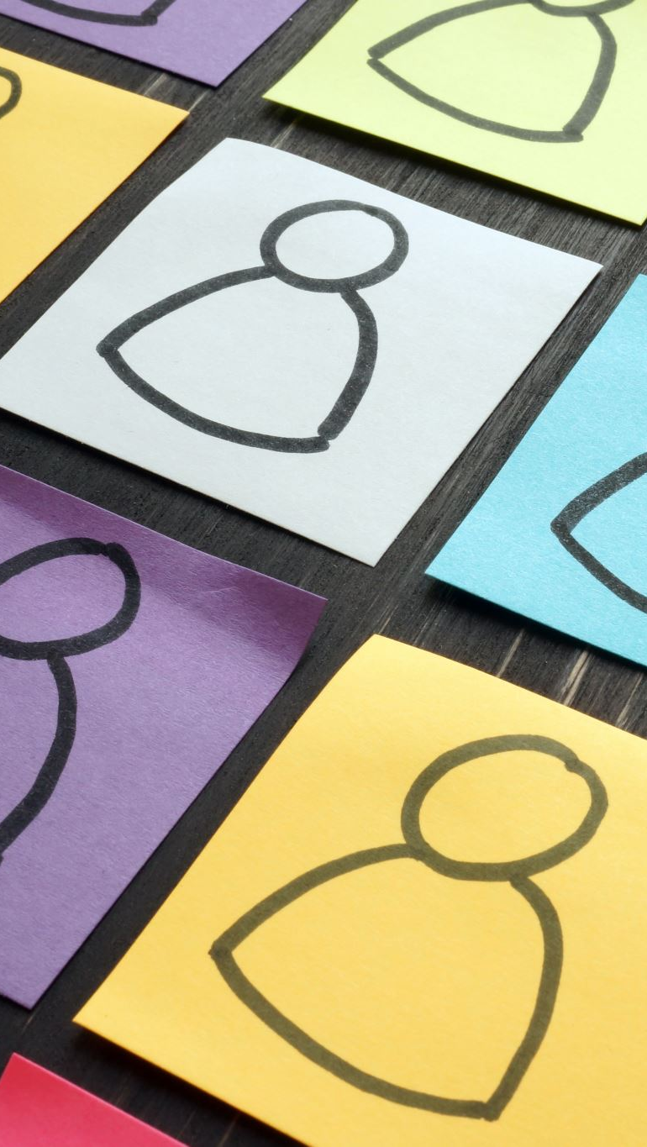
ALIBI!
Work together to think of an alibi for everyone in your group. "I was ~ing …."
Write the alibis down on the cards.
Hand all the cards to the teacher.
Everyone gets a card. Don't show anyone! If you have the "guilty" card, you are guilty!
Everyone reads their alibi. If you are guilty, you can say any alibi.
Everyone points at the person they think is guilty!

